Slide 1
Investor Pitch for VersaVogue
Fashion with Endless Possibilities

Slide 2
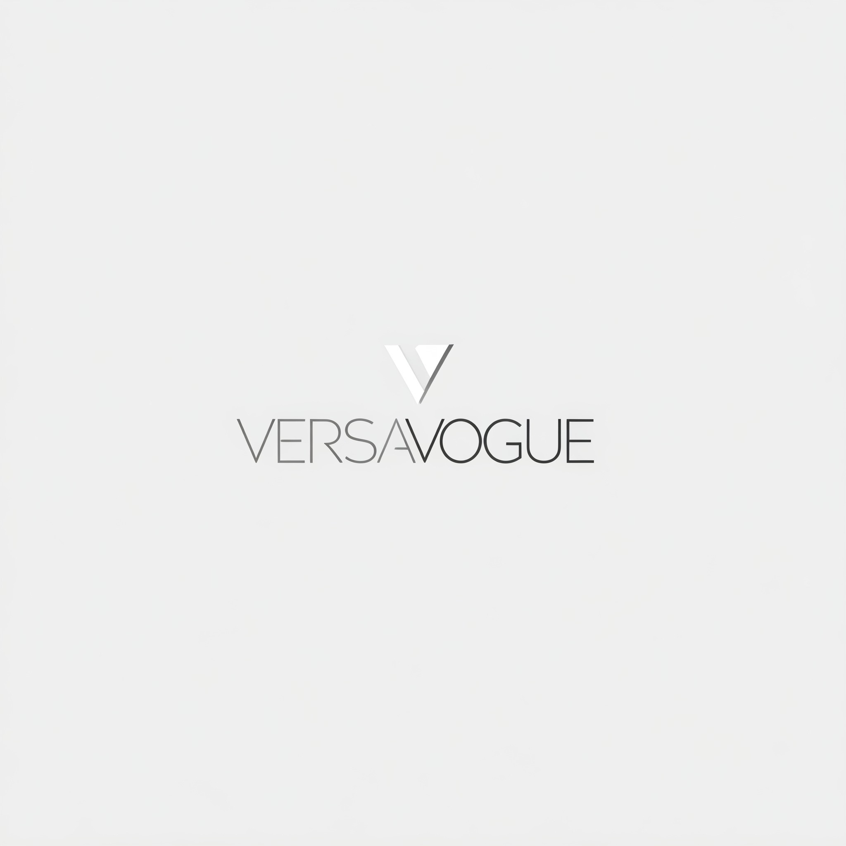
One Wardrobe, Infinite Styles
Revolutionizing modular clothing for a sustainable, stylish future

Slide 3
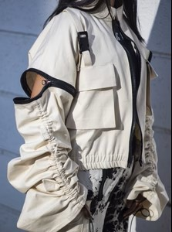
VersaVogue: Redefining Fashion with Endless Possibilities
Transform Your Wardrobe, Redefine Your Style.
Modular Clothing lets you mix, match, and transform your wardrobe with ease. Detachable sleeves, collars, and hemlines create endless style possibilities, all in one piece. Style made simple, sustainable, and uniquely yours.

Slide 4
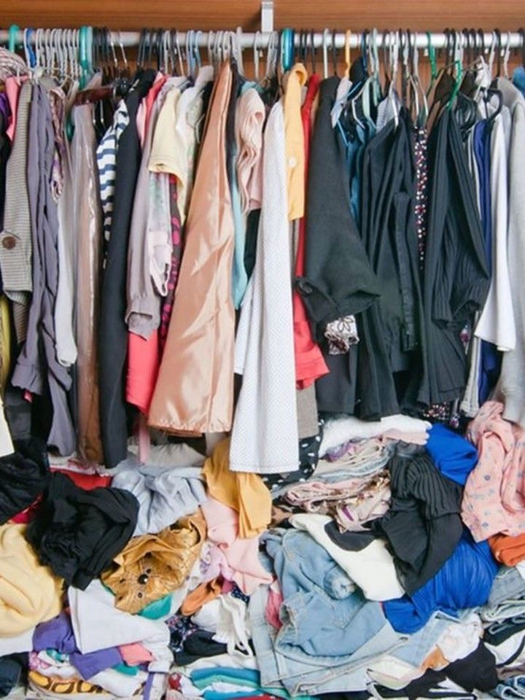
The Challenges in Fashion Today
1. Cluttered Closets, Unmet Needs
"A closet full of clothes, but still, 'nothing to wear.'"
Overwhelming wardrobes fail to meet diverse styling needs.
2. Expensive Trends
"Fashion evolves fast, and staying trendy is expensive."
Consumers spend excessively to keep up with fleeting trends.

Slide 5
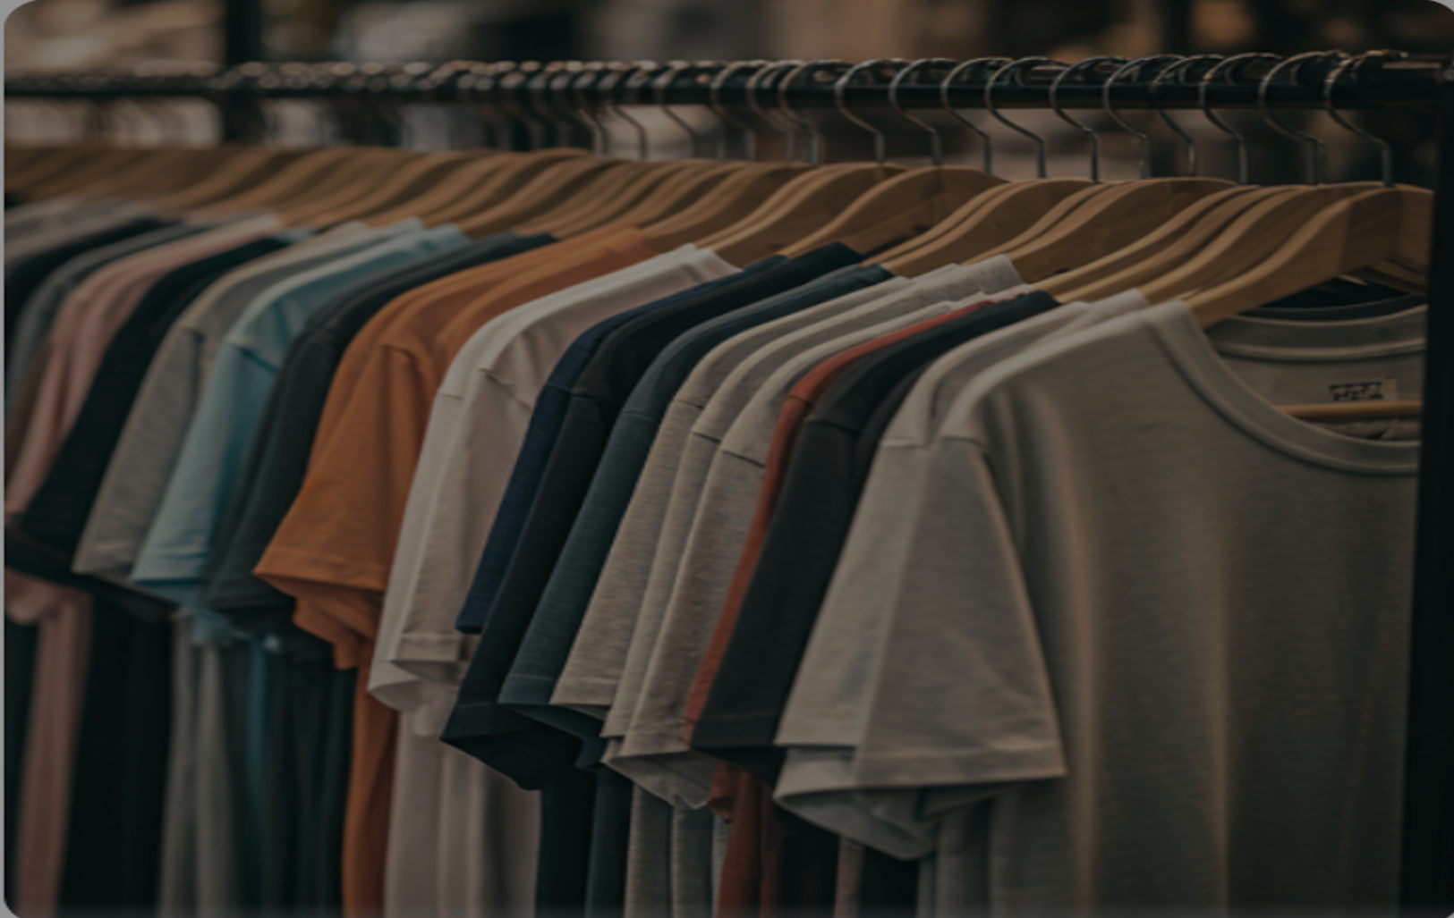
3. Environmental Impact
"Fast fashion is more than a trend—it's a problem."
Contributes to 10% of global carbon emissions.
Creates millions of tons of waste annually, harming ecosystems.
4. Lack of Versatility
"One outfit, one use—what if clothes could do more?"
Limited multifunctional options for busy, modern lifestyles.

Slide 6
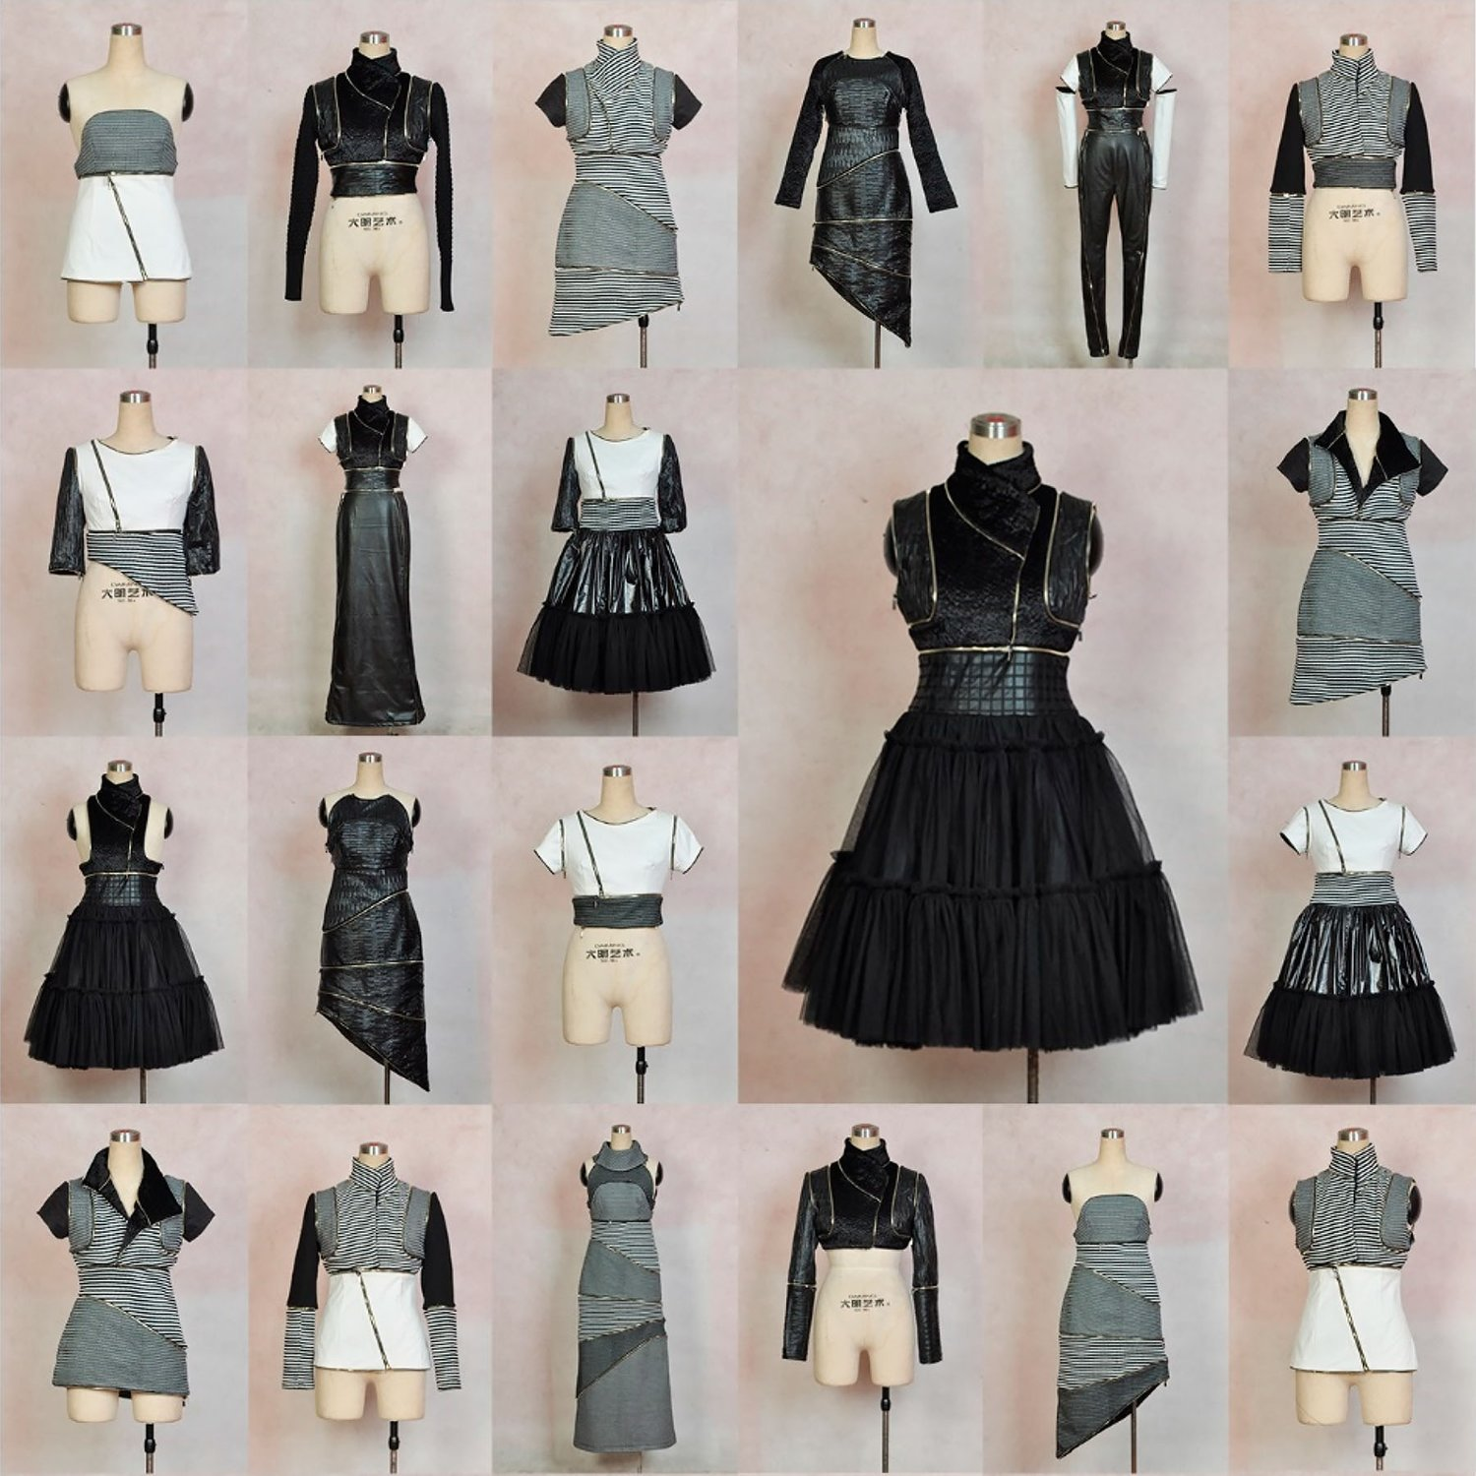
VersaVogue: Endless Style, Zero Waste
1. Endless Possibilities
"Modular clothing with detachable parts—style reimagined."
Mix-and-match designs offer infinite outfit combinations.
2. Sustainable & Eco-Friendly
"Fashion that cares for the planet."
Made with sustainable materials to reduce waste.
Designed for eco-conscious consumers.

Slide 7
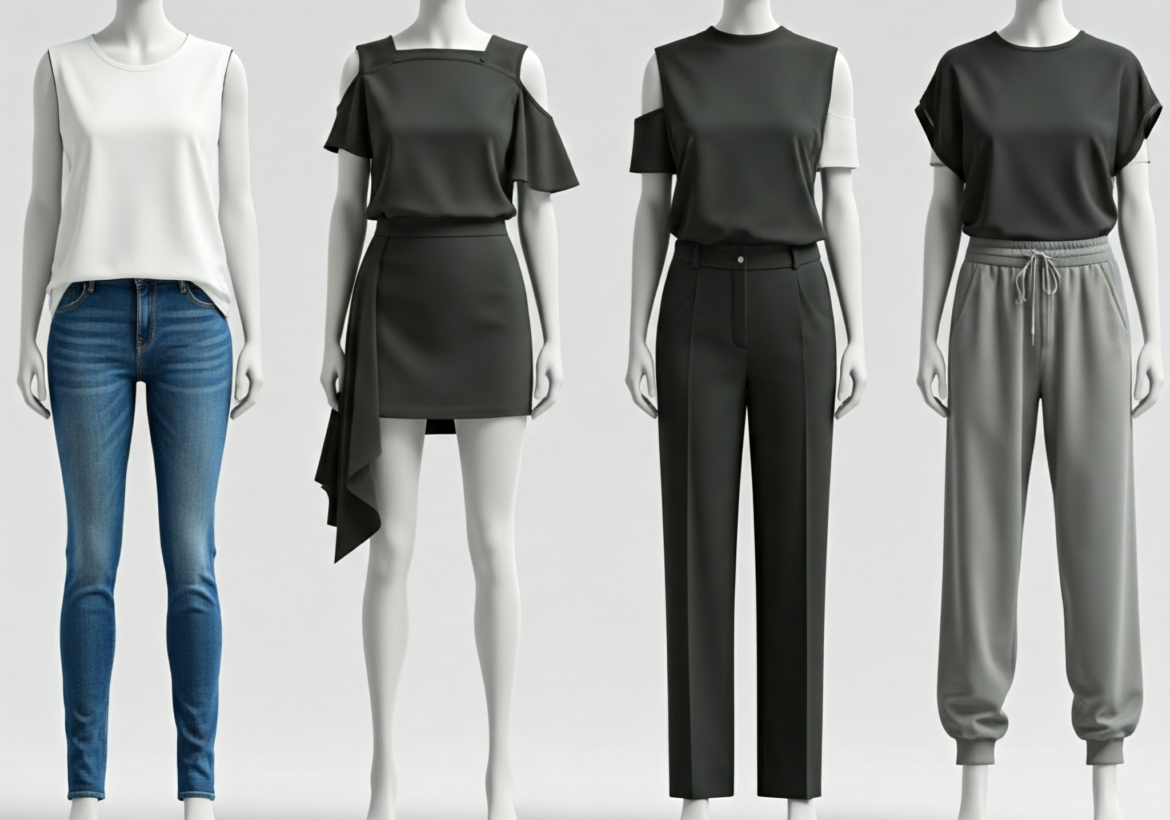
3. Lightweight & Versatile
"Perfect for the modern lifestyle."
Easy to carry, wear, and transform for any occasion.
Ideal for travelers, minimalists, and trendsetters.
"Why own more when you can do more with less?"

Slide 8
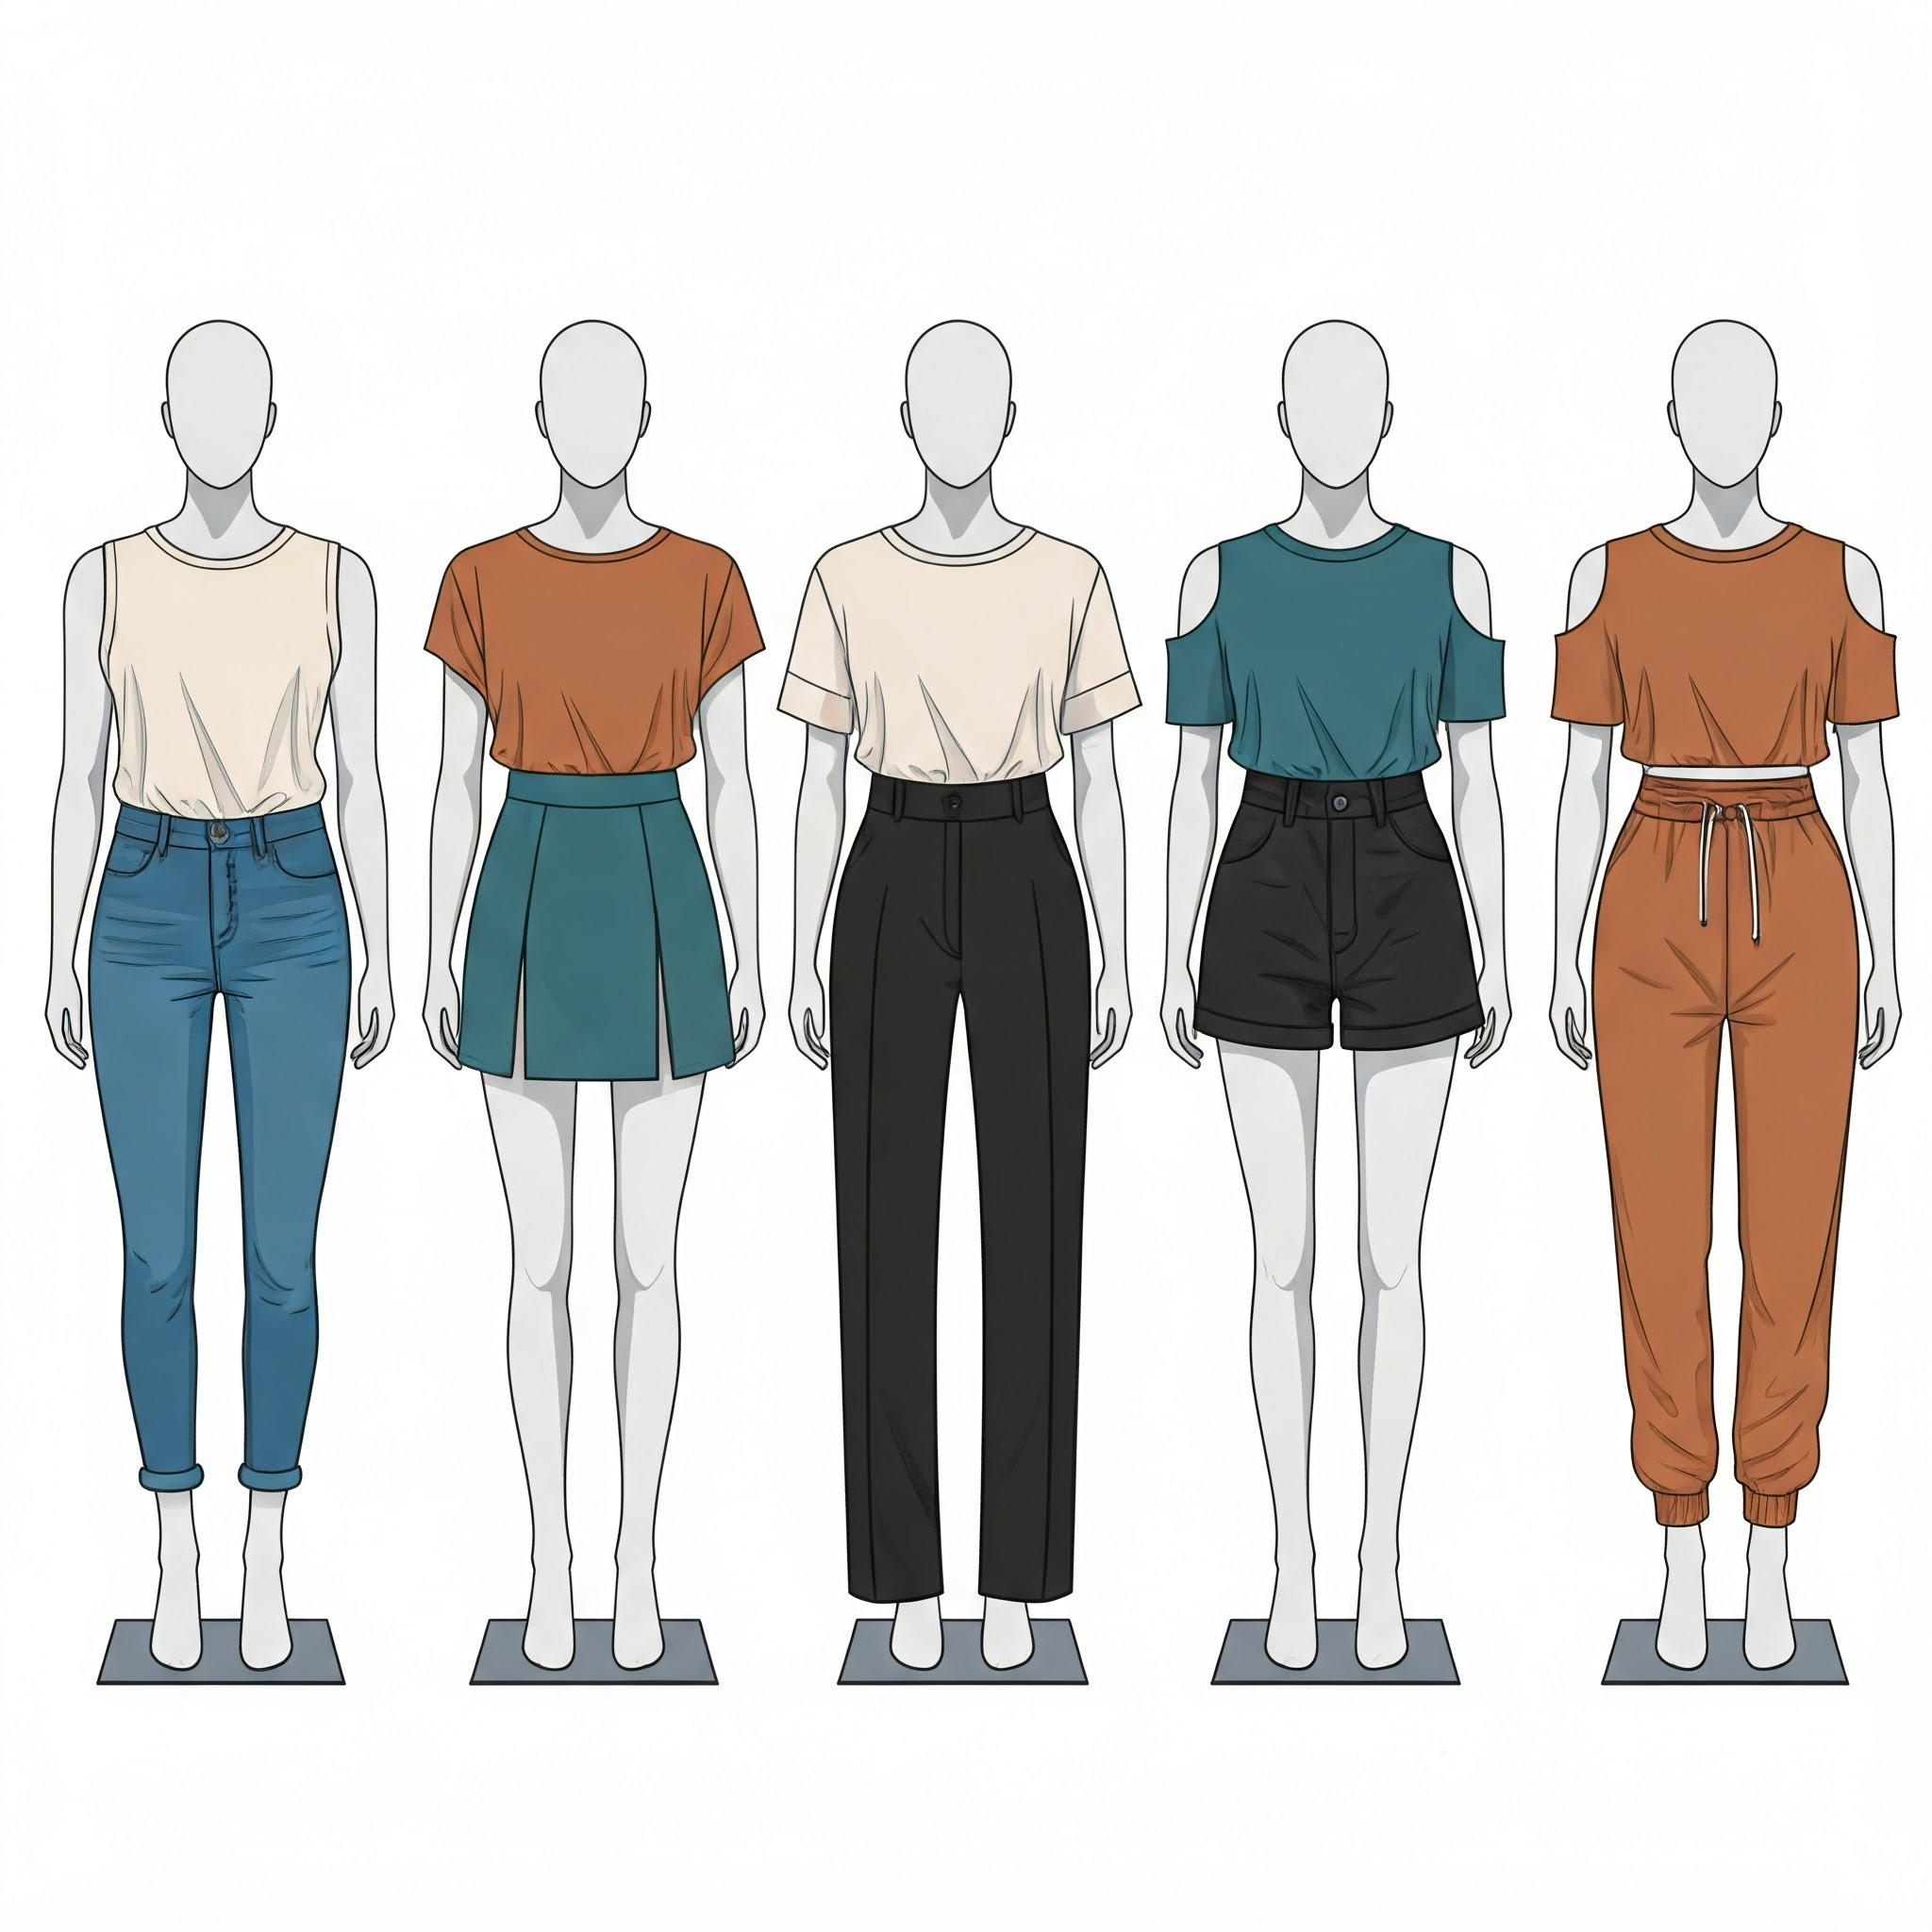
Why VersaVogue Stands Out
1. Modular Design
"Style without limits."
Seamlessly mix and match to create a wardrobe that evolves with you.
2. Inclusive & Customizable
"Fashion for everyone."
Available in a wide range of sizes with customization options.

Slide 9
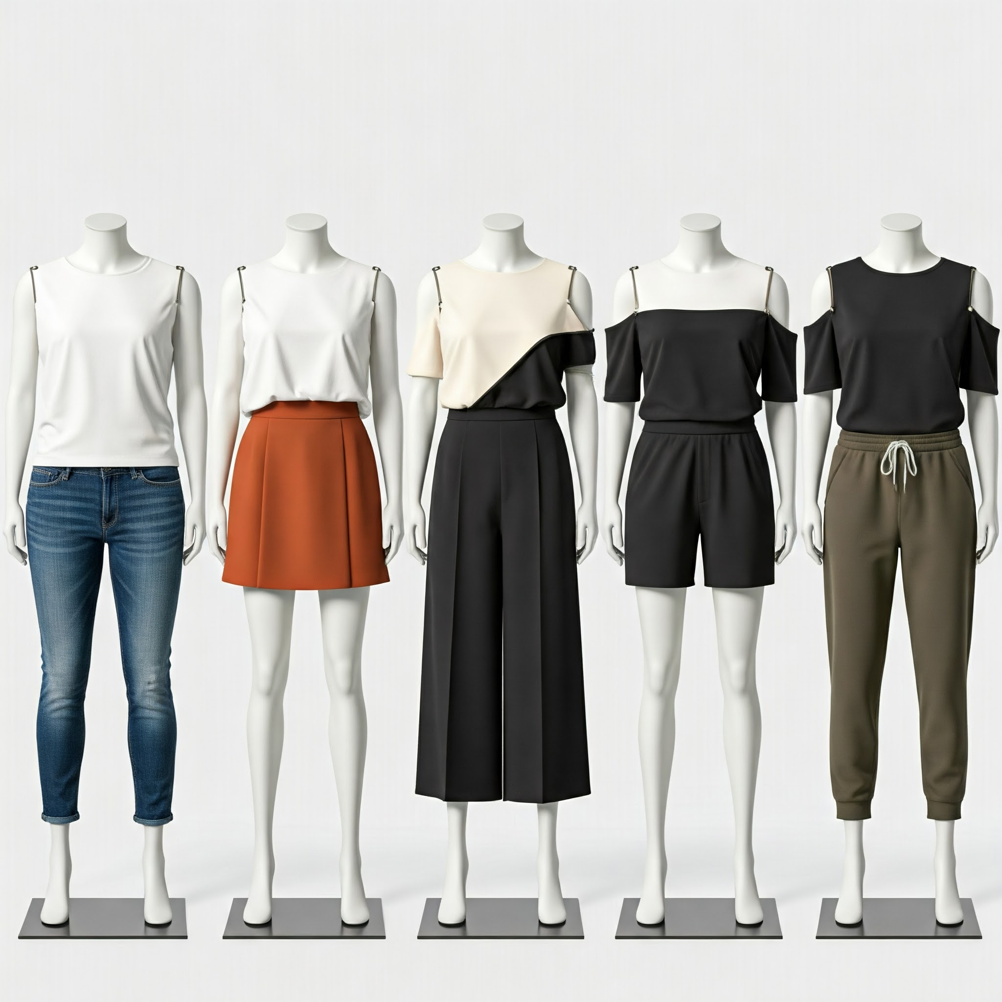
3. Easy Assembly
"Fashion made simple."
Innovative snap-on, zip, or magnetic modules for quick customization.
4. Versatile for Every Occasion
"One outfit, multiple vibes."
Transition effortlessly between work, casual, and formal wear.
5. Premium, Sustainable Fabrics
"Luxurious feel, eco-friendly heart."
Made from high-quality, sustainable materials designed to last.

Slide 10
Who We’re Dressing
Primary Audience
"The Style Seekers"
Fashion-forward individuals, aged 18–40, looking for unique, transformative clothing.
Secondary Audience
"The Practical Pioneers"
Travelers: Need lightweight, versatile wardrobe solutions.
Minimalists: Prefer fewer, multi-functional pieces.
Eco-Conscious Buyers: Value sustainable, eco-friendly fashion.

Slide 11
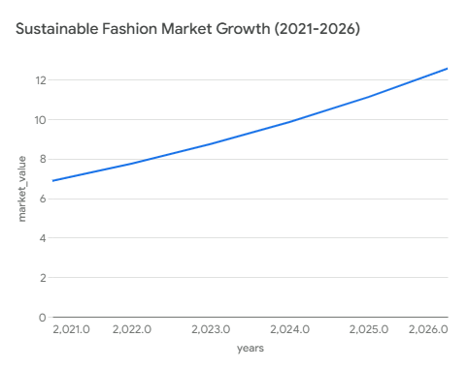
Market Opportunity
Sustainable Fashion Market: Projected to reach ₹68,475 crore by 2026.
Rising need for versatile, space-saving clothing solutions in urban markets.

Slide 12
How VersaVogue Makes Money
1. Revenue Streams
Direct-to-Consumer (D2C):
Sell directly through e-commerce platforms for maximum reach.
Subscription Boxes:
Offer seasonal modules with exclusive styles for recurring revenue.
Partnerships & Licensing:
Collaborate with fashion brands and eco-conscious organizations.
2. Recurring Revenue
Upselling:
Offer limited-edition styles and premium modules.
Loyalty Programs:
Incentivize repeat purchases with discounts and early access.

Slide 13
3. Pricing Strategy
Base Outfit:
Starting at ₹5,000 for core modular sets.
Add-Ons:
Accessories and extensions priced between ₹500–₹2,000.

Slide 14
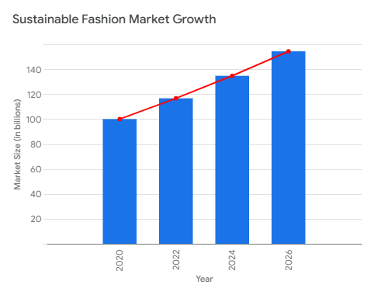
The Fashion Revolution is Here
Global Fashion Market
Market Size: ₹1,41,10,000 crore.
Growth in Sustainable
Fashion: Expanding at 8% annually, driven by eco-conscious consumer demand.

Slide 15

2. Addressable Market
Targeting discerning young professionals and environmentally conscious individuals in urban centers. Positioned to meet the growing demand for sustainable, adaptable, and high-end fashion solutions.

Slide 16
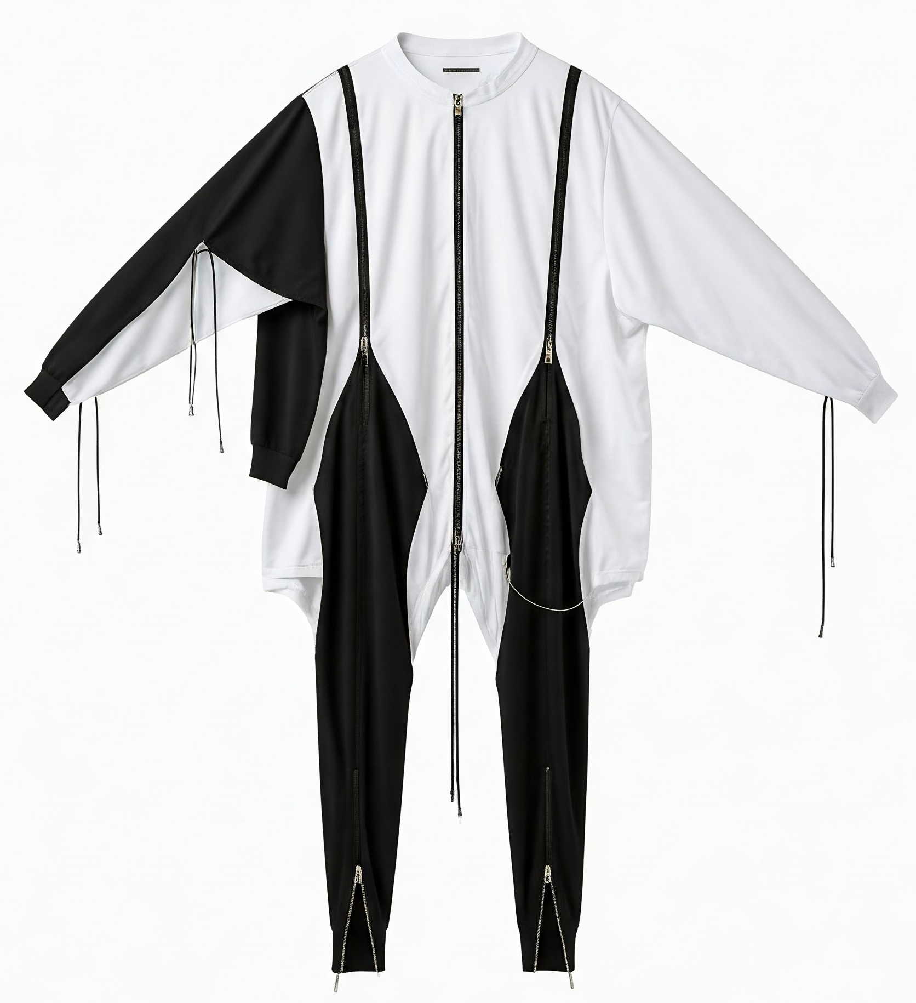
Why VersaVogue Will Lead the Market
1. Unique Value Proposition
"Fashion that adapts, without compromise."
Boundless styling possibilities, delivering unmatched versatility for every moment
2. First-Mover Advantage
"Leading the modular fashion revolution."
Limited competition in the modular clothing market.
3. Technology & Design
"Innovation meets elegance."
Patentable modular clothing technology for snap-on, zip, or magnetic assembly.

Slide 17
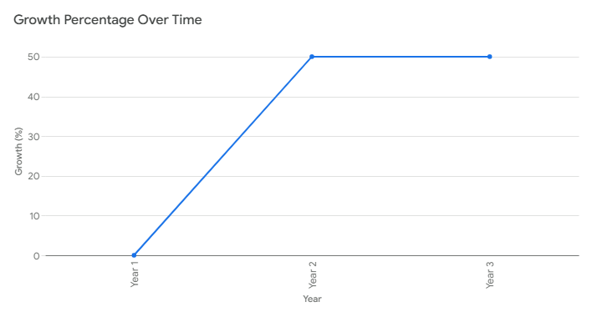
VersaVogue: Financial Projections
1. Growth Projections
50% Year-over-Year (YoY) growth expected for the first 3 years.
Driven by increased market penetration and recurring revenue streams.

Slide 18
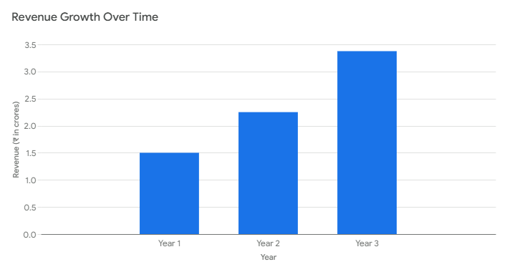
2. Year 1 Revenue Goal
₹1.5 crore (~$180,000) projected revenue in the first year
3. Profit Margins
Estimated at ~60%, leveraging scalability of modular components.
High margins due to efficient production and premium pricing.

Slide 19
Be Part of the Revolution
1. Funding Required
₹75 lakh (~$90,000) to bring VersaVogue to life.
2. Usage of Funds
Product Development: 35%
Marketing: 30%
Operations: 10%
Technology: 20%
Miscellaneous: 5%
3. Return on Investment (ROI)
Expected 3x returns within 5 years.

Slide 20

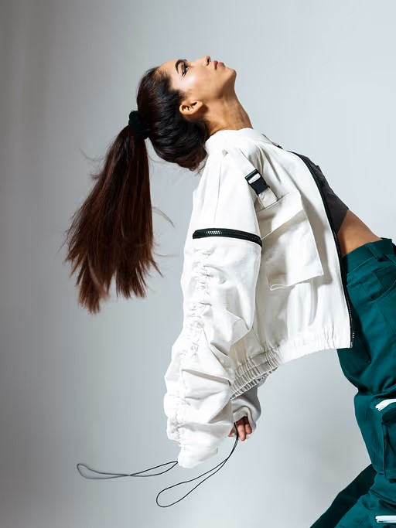
How We’ll Make VersaVogue a Household Name
1. Digital Marketing
"Reaching where our customers thrive—online."
Social Media Ads:
Targeted campaigns on platforms like Instagram, Facebook, and Pinterest.
Influencer Campaigns:
Partner with fashion and sustainability influencers for authentic promotion.
2. Strategic Partnerships
"Collaboration is the new innovation."
Collaborate with sustainable brands for co-branded collections.
Partner with NGOs to promote eco-conscious living and align with social responsibility.

Slide 21
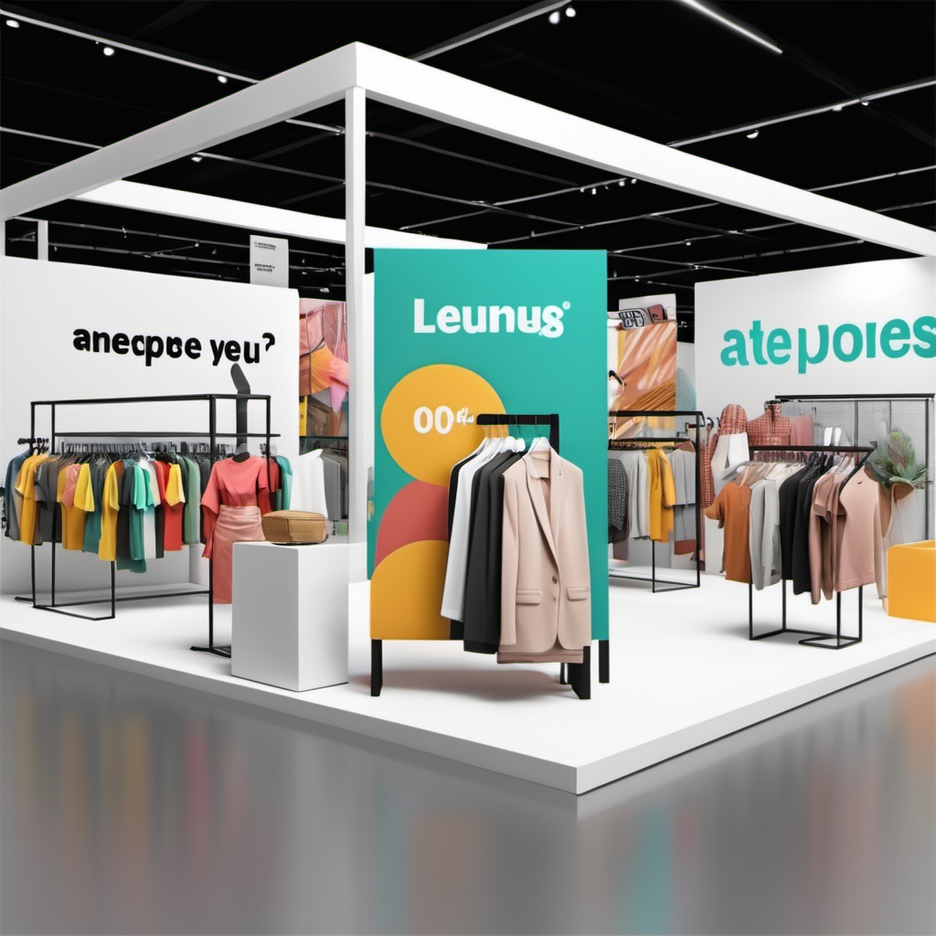
3. Offline Presence
Fashion Expos:
Showcase modular designs at premium events.
Pop-Up Stores:
Temporary, curated shopping experiences in urban hotspots.

Slide 22
The Team Behind VersaVogue
1. Our Expertise
"A blend of passion and professionalism."
Experts in fashion, sustainability, and business innovation.
Proven track record in driving success in emerging markets.
2. Key Achievements
Fashion Lead: Designed collections featured in top fashion expos.
Sustainability Advisor: Implemented eco-friendly practices for multiple brands.
Business Strategist: Spearheaded startups with multi-crore turnovers.
CORE TEAM

Slide 23

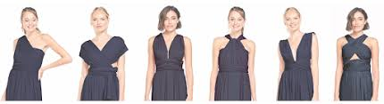


Join the Fashion Revolution
"Together, let’s redefine fashion and sustainability."
info@versavogue.com
+91-98765432XX
www.versavogue.com
"Let’s connect to shape the future of fashion. Schedule a meeting or reach out to us anytime."

Slide 24
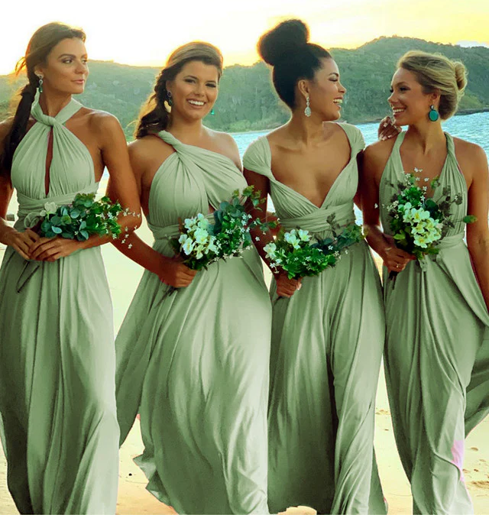

THANK YOU

